Slide 1

A project on
Resume classification
Ankit Bansal
Sandeep Patil
Pyumori Deosthale
Sonali Jagtap
Tejas Kulkarni
Varun kumar juluri
Ganesh Samgir

Slide 2

Problem Description
Natural language processing (NLP) is a machine learning technology that gives computers the ability to interpret, manipulate, and comprehend human language.
Organizations today have large volumes of voice and text data from various communication channels like emails, text messages, social media newsfeeds, video, audio, and more.
They use NLP software to automatically process this data, analyze the intent or sentiment in the message, and respond in real time to human communication.
Natural language processing (NLP) is a machine learning technology that gives computers the ability to interpret, manipulate, and comprehend human language.
Traditional Machine learning NLP techniques:
Logistic regression:- is a supervised classification algorithm that aims to predict the probability that an event will occur based on some input. In NLP, logistic regression models can be applied to solve problems such as sentiment analysis, spam detection, and toxicity classification.
Naive Bayes :-is a supervised classification algorithm that finds the conditional probability distribution P(label | text) using the following Bayes formula.

Slide 3

Data Description
We have data set:-
Resume:-
Resumes, Category

Slide 4

EDA
Shape of data set:-
Duplicate value of data set :-13

Slide 5
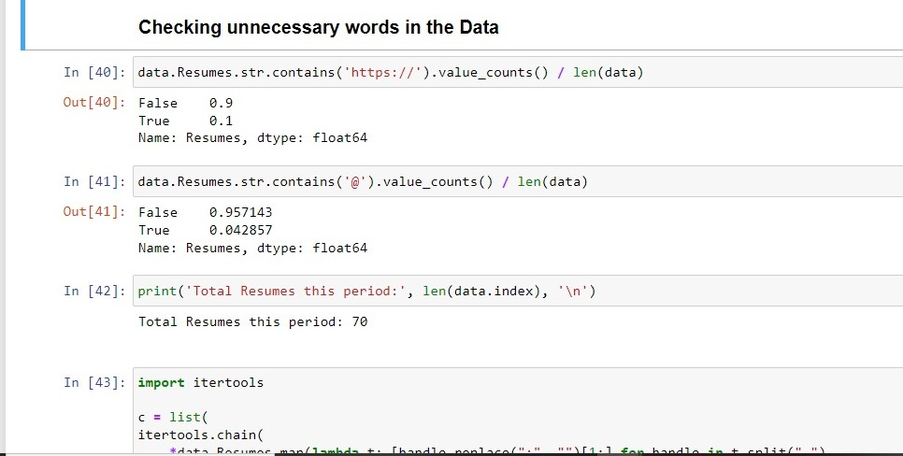
Work we done with resume data set
Here we checked unnecessary words in data
And also check resume top words by visualization

Slide 6
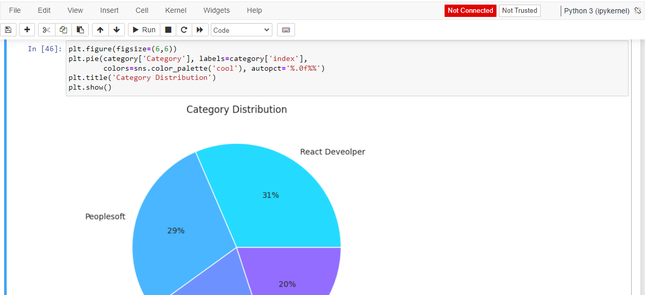
Visualizations of data set
We have done many visualizations of the data set like pie chart, Bar chart In this pie chart , We visualize category wise distribution

Slide 7
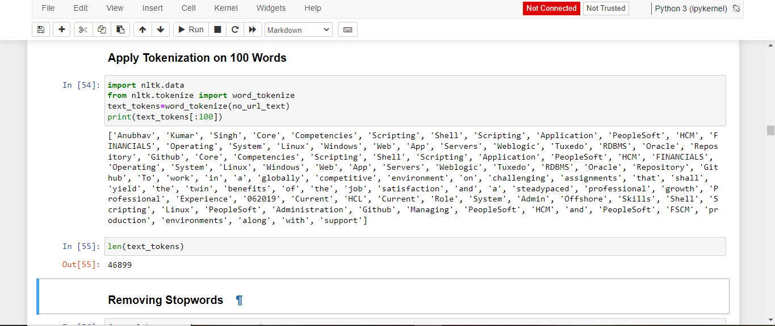
Tokaniazation
Here we apply tokenization on 100 words and also removing step words

Slide 8
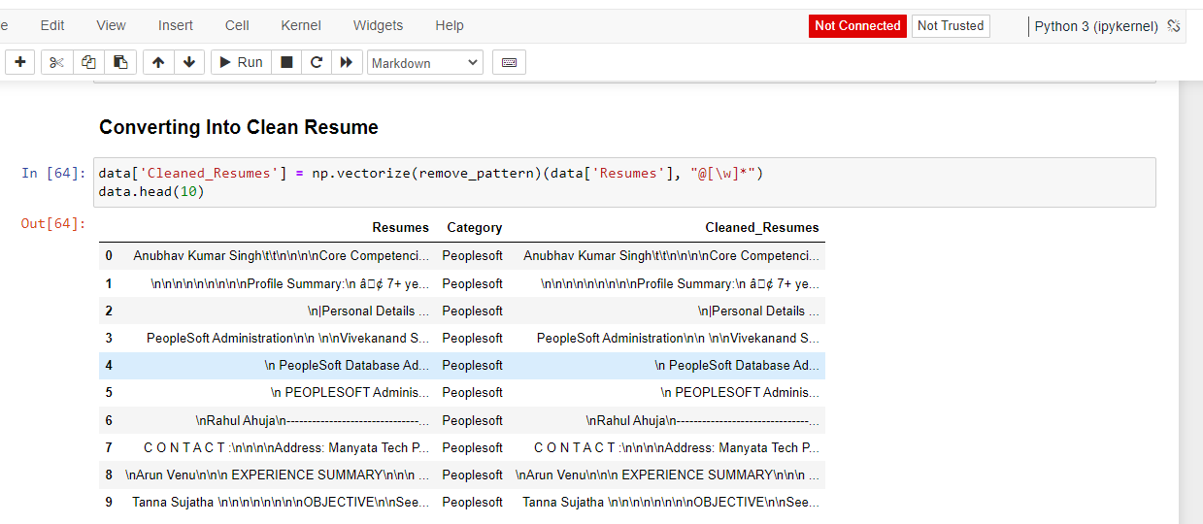
Converting into Clean resumes
Here We converting into clean resume also removing URL from clean resume and removing duplicate resumes.

Slide 9
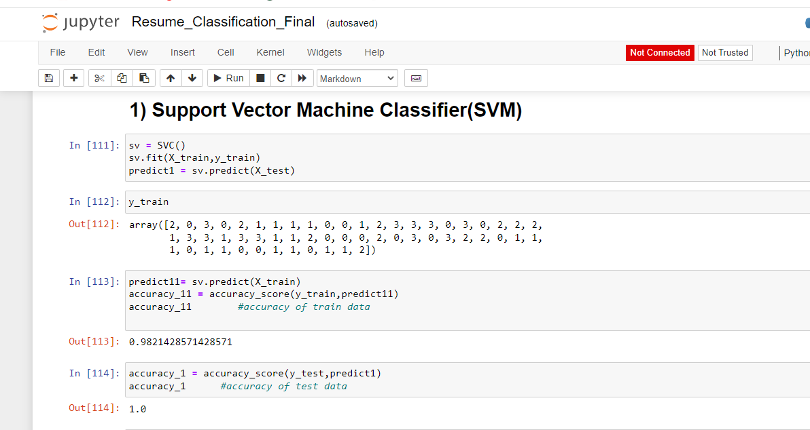
Model building
Here we create different models like
SVM
random forest classifier,
k neighbour classifier, Naive bayes,
Decision tree classifier,
Adaboost classifier,
XG boost
LGBM boosting classifier,
Multinominal logistic regression.
also we create heat map of each classifier

Slide 10
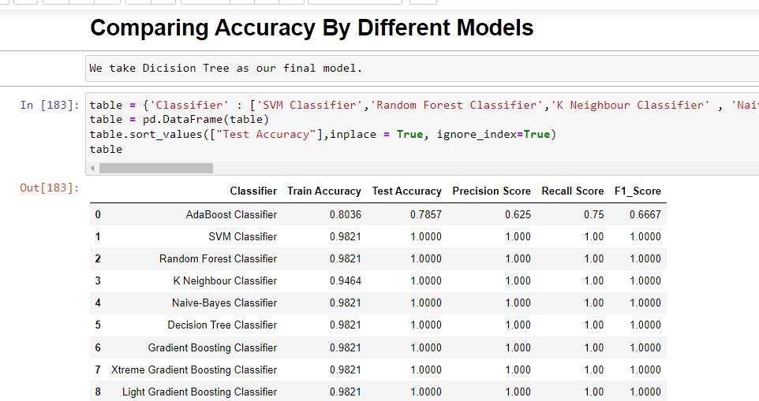
Comparing Accuracy By Different Models

Slide 11
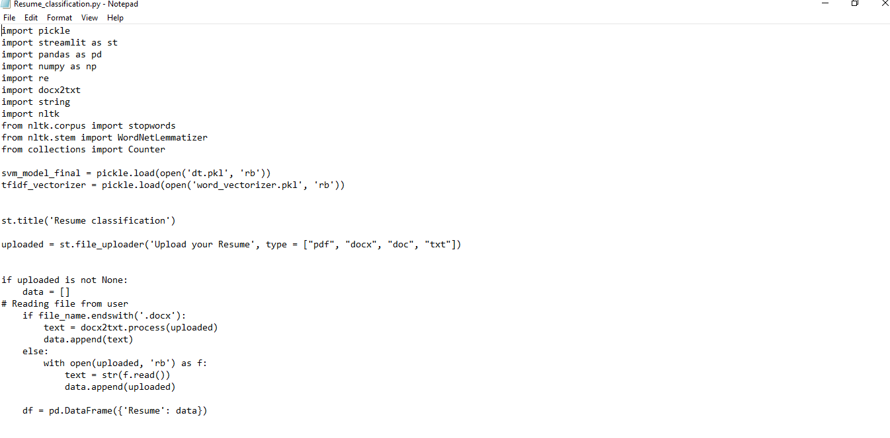
Deployment
It is our pickle file

Slide 12
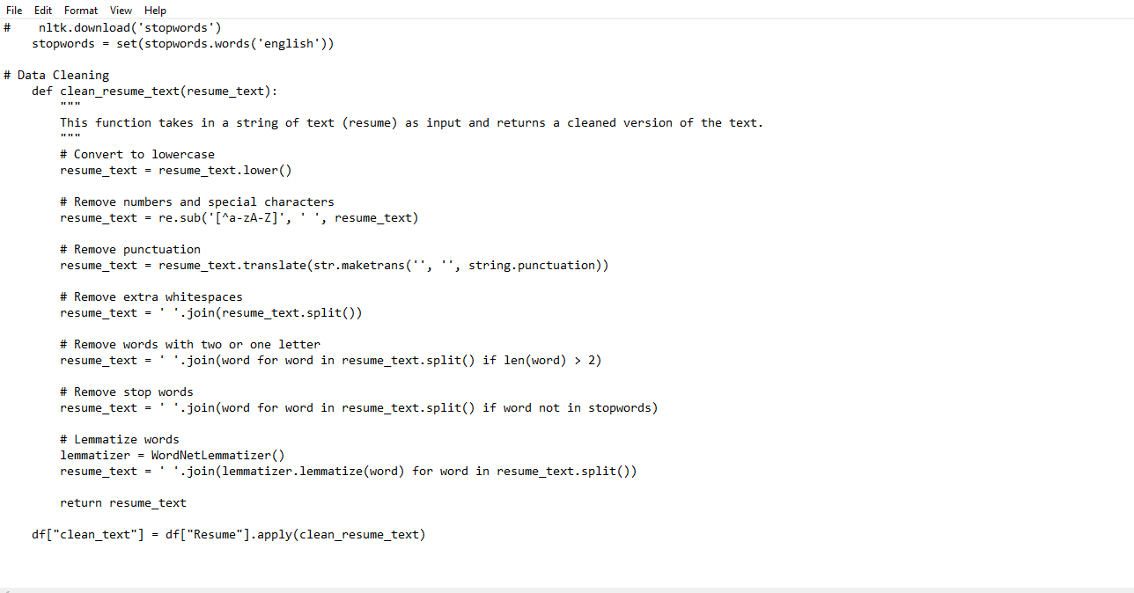
Data Cleaning part
Here we create data cleaning part

Slide 13
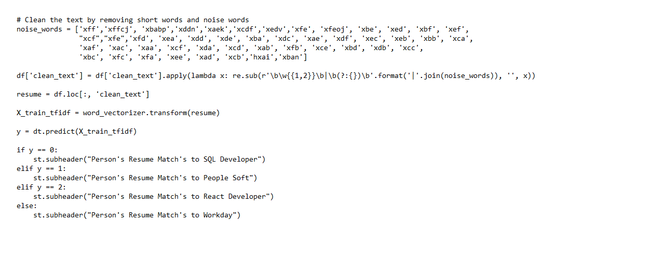
Codes for our webpage
We create codes for the webpage.

Slide 14
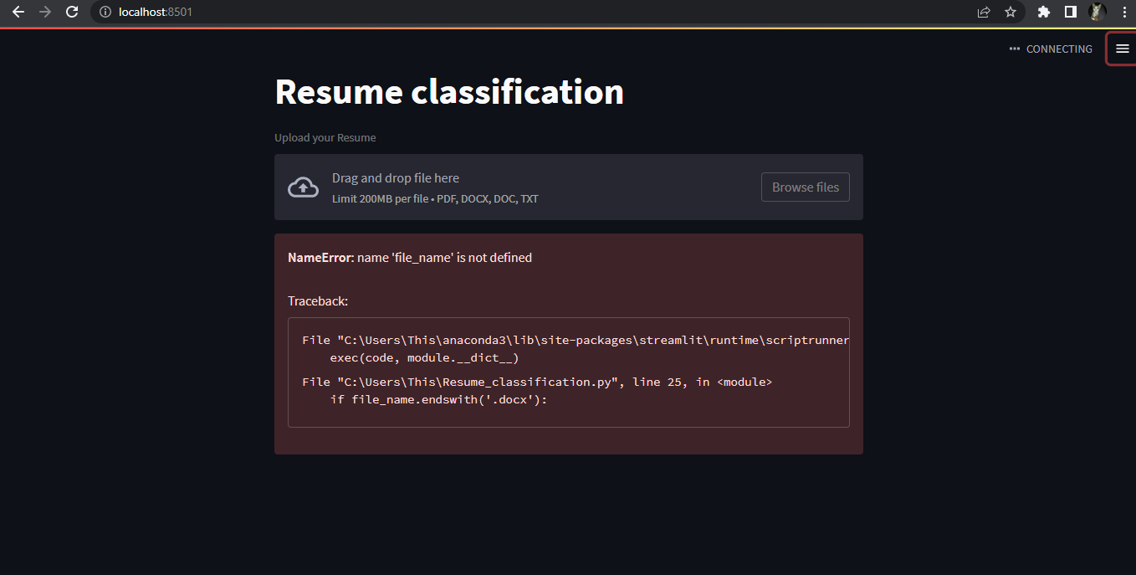
Webpage
This is our webpage

Slide 15
Thank you

